Slide 1

      August 28, 2026 Elias A.(RA at EHEPA)
Capacity, Barriers, and Enablers
of SBC in Ethiopia
A Comprehensive Assessment among SBC Implementing Organizations
www.ehepa.org
Notes:
Welcome participants and introduce the purpose of the workshop, to share findings from the national SBC capacity assessment. Emphasize that this study provides evidence to guide institutional strengthening and policy integration across sectors.

Slide 2
Presentation Outline
Study Scope & Expected Outcomes
Background of SBC in Ethiopia
Problem Statement: Systemic Challenges
Study Aim and Objectives
Methods
Key Findings
Lessons Learned
Conclusion
Recommendations
www.ehepa.org

Slide 3
Study Scope & Expected Outcomes
Study Scope
Assess capacities, barriers, and enablers of SBC across multi-sectoral organizations in Ethiopia.
Generate actionable, localized evidence to strengthen SBC systems and integrate SBC within Ethiopia’s national development priorities.
Expected Outcomes
Institutionalized SBC frameworks.
Domestic financing strategies.
www.ehepa.org

Slide 4
Background of SBC in Ethiopia
SBC: A Strategic Pillar
SBC is central to Ethiopia’s public health and development agenda, serving as a critical mechanism to address deep-rooted behavioral and social determinants.
    Addressing social determinants
    National development integration
    Multi-sectoral engagement
www.ehepa.org
Notes:
Leveraging SBC to move beyond service delivery, focusing on sustainable habit formation and social norm transformation to improve long-term outcomes in health, nutrition, and education.

Slide 5
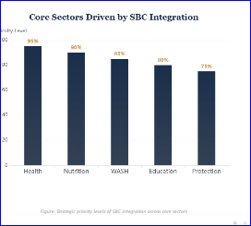
Background of SBC in Ethiopia ...
SBC integration is strongest in health and nutrition sectors.
Limited global data on SBC capacity; limited studies in SBC area
This study explores capacity, barriers, & facilitators of SBC implementation
www.ehepa.org

Slide 6
Problem Statement: Systemic Challenges
The fragmentation of SBC implementation across organizational and operational dimensions hinders sustainable behavioral outcomes.
Dimension | Status & Key Challenges
Organizational & Workforce | Weak institutional capacity, absence of dedicated SBC career paths, and high staff turnover.
Coordination | Fragmented multi-sectoral collaboration; activities driven by donor priorities.
Evidence & Monitoring | Insufficient research on behavioral drivers; monitoring systems over-emphasize outputs.
The Ethiopian SBC ecosystem is at a bottleneck. Systemic barriers are rooted in structural fragmentation rather than just funding shortages.
www.ehepa.org
Notes:
Crossroads between isolated projects and national systems: The Ethiopian SBC ecosystem is at a bottleneck, transitioning from "project-driven" to "institutionalized" systems. Systemic barriers are rooted in structural fragmentation and lack of professional retention, rather than just funding shortages.

Slide 7
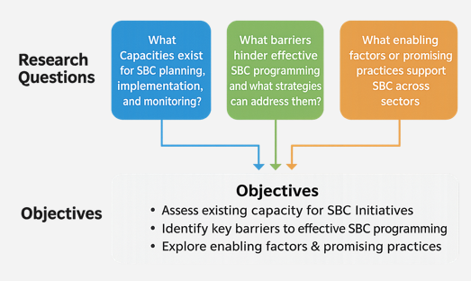
Study Aim : Research Questions and objective
Aimed
To assess the capacities, barriers, and enablers of SBC among selected implementing organizations in Ethiopia.
www.ehepa.org
Notes:
Implementation Focus: This qualitative study assesses 44 organizations (Government, NGOs, Private Sector) to provide evidence-based support for a government-led, community-owned sustainable SBC system.

Slide 8
Methods and Materials
Study Design: Exploratory qualitative study from November to December 2025
Method Component | Detailed Implementation
Sampling Strategy | Maximum variation sampling of 44 organizations. Sector representation e.g. Gender, WASH, Nutrition etc.. Information saturation applied.
Capacity Assessment | 30 organizations evaluated using a structured checklist adapted from the C-Change SBCC.
Primary Data Collection | Conducted 26 IDI and 18 KII with SBC practitioners, program implementers, and senior representatives.
Analytical method | Thematic analysis was done
www.ehepa.org
Notes:
Core Focus of Assessment: Evaluating institutional and operational capacity by assessing human resources, multi-sectoral coordination mechanisms, domestic and donor financing, and technical monitoring tools

Slide 9
Sampling and Participants: A Multi-sectoral Representation
Participant Composition by Organization Type
Organization Category | Key Representatives Included
Government Sector | Ministries (MoWSA, MOE, MOH) & Regional Health Bureaus
Development Partners | UN Agencies, International & Local NGOs
Civil Society | Community and Faith-Based Organizations (CBOs/FBOs)
Private Sector | Private sector working on SBC
www.ehepa.org
Notes:
Data Insight: To ensure a holistic view of the SBC landscape, 44 organizations were strategically selected using maximum variation sampling. This diverse cohort bridges the gap between high-level policy (Ministries) and community-level implementation (CBOs/FBOs), providing a comprehensive assessment of institutional capacity and operational barriers across Ethiopia.

Slide 10
Data Collection Tools:
Mixed-Methods Approach for Comprehensive SBC Assessment
Assessment Component | Tool/Source | Sample Size | Key Focus Areas
Quantitative Capacity Checklist | Adapted C Change SBCC Quality Assessment Tool (Ethiopian Context) | 30 Orgs | HR, Financing, Coordination, Technical Tools, M&E
In-Depth Interviews (IDIs): | Semi-structured Qualitative Guides | 26 Practitioners | Operational experiences, barriers, and technical gaps
Key Informant Interviews (KIIs) | Semi-structured Expert Protocols | 18 Stakeholders | Strategic direction, policy enablers, and sustainability
www.ehepa.org
Notes:
Analysis Logic: The assessment utilized a rigorous triangulation of data, blending a structured capacity checklist, modified for the Ethiopian context, with 44 qualitative interviews to capture both systemic metrics and nuanced institutional insights.

Slide 11
Rigor and Trustworthiness
1. Credibility (Triangulation, peer debriefing, and expert review of interview guides)
2. Transferability (Thick, context-rich descriptions)
3. Dependability (Codebook development, audit trail of coding decisions)
4. Confirmability (reflexive journaling, independent coding by multiple coders, and grounding of findings in participant narratives).
www.ehepa.org

Slide 12
Study Findings
www.ehepa.org

Slide 13
Socio-demographic Profile of Participants
Category |  | Number of Participants
Sex Distribution | Male | 29
 | Female | 15
Educational Level | MPH | 22
 | MA | 9
 | MSc | 8
 | PhD Candidate | 3
 | Other (BA/MD, mixed degrees) | 2
Years of SBC Experience | Shorter (2–4 years) | 11
 | Mid-Level (5–10 years) | 19
 | Long-Term (15–20+ years) | 10
 | Unspecified | 4
Role/Position Categories | Advisors (SBC/Communication) | 14
 | Directors/Managers | 12
 | Coordinators/Team Leads | 10
 | Specialists/Officers | 8
Category |  | Number of Participants
Data Source | IDI | 26
 | KII | 18
Sector | Health (MOH/RHBs/WHO) | 15
 | CSO/FBO | 7
 | Nutrition NGOs | 5
 | WASH/Water | 5
 | UN Agencies | 4
 | Education | 4
 | Private Sector | 3
 | Gender/Social Affairs | 1
www.ehepa.org

Slide 14
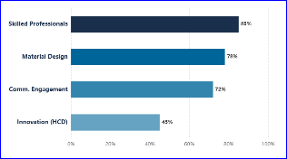
Key Findings: Human Resources and Expertise
SBC Technical Capacity Assessment (N=30 Organizations)
Data Insights: Ethiopia demonstrates a robust foundation in SBC human resources, with over 80% of organizations possessing skilled professionals.
www.ehepa.org
Notes:
Emphasize Ethiopia’s strong foundation, a capable workforce and growing recognition of SBC as a strategic, evidence‑driven approach.

Slide 15
Key Findings
Emerged Themes
Five themes emerged from the KII/IDI data
Theme 1. Strengths in SBC Programming
Theme 2. Barriers in SBC Programming
Theme 3. Enablers of SBC Programs
Theme 4. SBC Best practices
Theme 5. Participants’ suggestion
www.ehepa.org
Notes:
Themes 1–3
SBC Design: “This theme highlights how frameworks and policies guide SBC design but often overlook behavioral insights. Strengthening participatory design and evidence‑based prioritization is essential.”
SBC Implementation: “Implementation varies widely across organizations. Documentation and capacity gaps persist, but harmonizing approaches and sharing best practices can improve consistency.”
SBC Structure & System: “Organizational roles and coordination mechanisms remain fragmented. Building integrated systems and clarifying responsibilities will enhance efficiency.”

Slide 16
Theme 1. Strength in SBC Programming
Strengths in SBC Design
Theory-Driven Planning: High awareness and use of established frameworks to understand determinants of behavior.
Structured Design Processes: Utilization of the "P-Process" and formative assessments
Strategic Alignment: Strong capacity for aligning SBC objectives with National Health Promotion and Food & Nutrition strategies.
Audience Segmentation: High proficiency in identifying and segmenting audiences to tailor messaging effectively.
“We used the Health Belief Model and multiple behavior change models to assess barriers, perceptions, and guide intervention design.” — [IDI, Nutrition Program Manager]
www.ehepa.org
Notes:
Summary of Barriers to Success
Process Deficiencies: This misalignment leads to fragmented implementation and a design process that lacks meaningful community co-creation.
Institutional Fragility: High staff turnover and weak retention mechanisms within government and partner organizations continuously undermine technical expertise institutionalization.

Slide 17
Strength in SBC Program..
Strengths in SBC Implementation
Multi-Sectoral Collaboration: Effective integration across Health, WASH, Nutrition, and Education sectors
Diverse Communication Channels: Robust use of interpersonal communication (IPC), community dialogues, and entertainment-education.
Grassroots Infrastructure: Leveraging the Health Extension Program and community volunteers.
Standardized Tools: Wide availability of manuals, job aids, and technical guides.
“Each and every team works in collaboration in all components of the project... [it ensures] complex behavioral problems are addressed comprehensively.” — [KII, HE&HP Team Lead]
www.ehepa.org
Notes:
Key Findings: Implementation and Supervision
Capacity Domain & Key Enablers
Organizational Structure-Established SBC units and dedicated departments.
Supervision Mechanisms-Regular technical supportive supervision and feedback.
Guideline Adherence-Use of National SBC Guidelines and frameworks.
Technical Toolkits-Functional SBCC Quality Assessment and design tools.
Key Insights: The assessment reveals high institutional readiness with robust implementation structures and proficiency in utilizing technical tools for quality SBC delivery aligned with national standards.

Slide 18
Strength in SBC Program..
Strengths in SBC M&E
Systematic Evaluation Cycles: Established culture of conducting Baseline, Midline, and End-line assessments.
Digital Data Evolution: Growing use of electronic data collection tools for real-time tracking and increased data accuracy.
Mixed-Method Approaches: Capacity to combine quantitative surveys with qualitative insights and implementation research.
Internal Quality Control: Strong internal research teams in NGOs and MOH that reduce reliance on outsourcing.
“We collect all our data electronically using mobile devices, which allows us to gather and organize the information easily.” — [IDI, Senior Health and Nutrition Officer]
www.ehepa.org

Slide 19
Theme 2. Barriers in SBC Programming
Barriers for SBC Design
Donor-Driven Priorities: Thematic focus and geographic coverage are often dictated by donor requirements.
The "Iterative Gap": Design is inherently time-consuming and rushed project timelines.
Data Gaps: Lack of reliable, up-to-date local statistics.
Inconsistent Framework Use: While theory is known, its application is uneven across organizations.
Top-Down Misalignment: The SBC landscape is primarily characterized by a top-down approach.
“Even if community needs are identified, donor funding priorities often dictate the focus areas and scope of interventions.” — [KII, Senior SBC Advisor]
www.ehepa.org
Notes:
Discuss how these systemic weaknesses undermine sustainability and ownership. Note that many organizations operate in isolation, limiting synergy and long‑term impact.
Weak institutional structures and governance.
Donor dependence and short‑term funding.
Fragmented coordination and limited M&E systems.
High staff turnover and poor skill retention.

Slide 20
Barriers in SBC Programming ...
Barriers for SBC Implementation
Resource Limitations: Significant budget shortages for printing, multimedia airtime, and training.
High Staff Turnover: Frequent "brain drain" of trained SBC professionals and overloaded Health Extension Workers.
Structural Gaps: Absence of dedicated SBC units in some regional bureaus and unclear "ownership“.
Misinformation & Resistance: Deep-seated sociocultural norms and the spread of misinformation.
“From a capacity point of view, there is no dedicated structure that leads SBC with clear ownership... [it impacts] budgeting and monitoring.” — [IDI, WASH Technical Lead]
www.ehepa.org
Notes:
Summary of Barriers to Success
Process Deficiencies: This misalignment leads to fragmented implementation and a design process that lacks meaningful community co-creation.
Institutional Fragility: High staff turnover and weak retention mechanisms within government and partner organizations continuously undermine technical expertise institutionalization.

Slide 21
Barriers in SBC Programming ...
Barriers in M&E
The "Activity vs. Behavior" Trap: frequently count outputs rather than measuring behavioral change.
Fragmented Indicators: Indicators are often missing from routine national health information systems.
Budget Cuts for Evaluation: M&E budgets are often the first to be cut.
Methodological Difficulty: High complexity in attributing specific behavioral changes to a single intervention.
“The main challenge in monitoring SBC is that it is difficult to correctly identify and measure the exact behavioral change that has occurred.” — [IDI, Program Coordinator]
www.ehepa.org
Notes:
Monitoring and Evaluation Gaps: Shifting from Activity to Impact
The existing M&E landscape is characterized by a "Measurement Inversion," prioritizing implementation volume over transformation. Systemic fragmentation hinders tracking long-term health and development outcomes.
Measurement Misalignment: Systems rarely measure actual behavioral outcomes, focusing on short-term outputs due to a lack of longitudinal metrics.
Methodological Gaps: Absence of harmonized frameworks across sectors results in fragmented data that cannot demonstrate national-level impact.

Slide 22
Theme 3. Enablers of SBC Program
Enabling factors in SBC Design & Strategy
Human-Centered Design (HCD): Moving from top-down messaging to "bottom-up" solutions.
Centralized SBC Hubs: The establishment of university-led hubs to consolidate knowledge and avoid duplication of efforts.
Inclusion by Design: Intentional use of sign language, disability-friendly materials, and gender-inclusive imagery.
HCD Pilot Success: Iterative feedback loops with youth and vulnerable groups.
“We use Human-Centered Design… solutions emerge from the context itself”.— [KII, Senior Health and Nutrition Advisor]
www.ehepa.org
Notes:
Highlight that Ethiopia’s SBC ecosystem has promising enablers, collaboration, innovation, and professionalization efforts that can be scaled.
Community engagement and participatory design.
Cross‑sectoral collaboration.
Growing policy recognition of SBC.
Emerging professional networks (EHEPA, UNICEF, MOH).

Slide 23
Enablers of SBC Program ...
Enabling Factors for SBC Implementation
Faith-Based Partnerships: Engaging religious and clan leaders as "SBC Champions“.
Digital & Social Media Integration: Leveraging influencers, Entertainment Education, TikTok, and youth-focused platforms like "U-Report“.
Cascading Training Models: Transferring skills from the center to the periphery.
SBC Summits: National and regional platforms for knowledge sharing.
“Engaging faith-based organizations and religious institutions bring you better effects, as the local community respect them and accept them too.” — [IDI, Sanitation and Hygiene Officer]
www.ehepa.org

Slide 24
Enablers of SBC Program ...
Enabling factors in SBC Sustainability & System
Community Empowerment & Ownership: Moving from "delivering a message" to enabling communities to identify their own root causes and solutions.
Mainstreaming Budgets: Successful organizations are now integrating SBC costs into general project budgets.
Institutional Knowledge Transfer: Strategies that require project staff to transfer technical skills to regional government workers.
Academic Specialization: Emerging efforts to incorporate SBC into university curricula.
“If skills are transferred to regional professionals, they will continue the work whether the project phased out or not. This ensures continuity of expertise.” — [KII, Regional SBC Advisor]
www.ehepa.org
Notes:
Gaps
Uneven access to SBC training across levels and sectors
Weak behavioral outcome indicators in most M&E systems
Donor dependency limits long-term sustainability
No formal national SBC network or community of practice
High staff turnover, especially among junior staff
Limited use of digital platforms and social media for SBC
Material harmonization is weak — duplication and inconsistency exist

Slide 25
Theme 4. SBC Best Practices
SBC Design Best Practices
Centralized SBC hubs
Participatory planning and co‑creation
Cultural and linguistic contextualization: Tailoring strategies to the specific cultural and language needs of diverse populations.
Human‑Centered Design (HCD) for relevance and acceptance.
“We engaged the community continuously… incorporating their feedback to improve interventions and ensure they are relevant and accepted” (KII, HE&HP Team Lead).
www.ehepa.org

Slide 26
Best practices ...
SBC Implementation Best Practices
Participatory community engagement: Involve targeted communities early in needs assessments.
Multi‑sectoral collaboration: Merge programmatic actions to coordinate supervisory resources
Youth‑led and peer approaches: Leveraging peer education, school programs, and interactive youth exhibitions.
Structured frameworks and inclusivity: Applying modern, structured HCD frameworks
www.ehepa.org

Slide 27
Best practices ...
SBC Implementation Best Practices ...
Volunteer support networks: Mobilizing community volunteer networks and bridges the gap between formal programs and households.
Digital amplification and knowledge platforms: Partnering with social media influencers accelerates information dissemination.
“Using social media influencers helped expand reach and engage more young people.” — IDI, SBC Expert
www.ehepa.org
Notes:
Highlight how operational success depends on community trust, youth engagement, and digital innovation.

Slide 28
Best practices ...
SBC M&E Best Practices
Multilayered assessments: evaluations with mixed-methods research.
Behavioral outcome tracking: Tracking shifts KAP, social norms, and household dynamics.
Continuous, cyclical monitoring: Using real-time tracking data to iteratively adapt communication tools and core messaging.
System integration (DHIS2): Standardizing behavioral indicators and embedding them into national data repositories.
www.ehepa.org
Notes:
Explain the evolution from activity tracking to behavioral verification. Show the comparison table visually (old vs. new mindset).
What Works: Best Practices in Ethiopia's SBC Programs
Best Practice, Description, Evidence
Human-Centered Design (HCD)- Iterative design with community feedback loops. Used by multiple organizations; high adoption in design phase
Multi-Sectoral Collaboration- Health + WASH + Nutrition + Education working together. Coordination platforms exist but underutilized
Youth-Led & Peer Approaches- U-Report, school programs, peer education. Strong engagement in adolescent health programs
Religious Leader Engagement- Leveraging faith leaders for health promotion. Immunization support rose from 63% to 85% after religious leader engagement
SBC Hubs- Centralized knowledge platforms. Prevents duplication and promotes shared learning
Cascading Training- National → Regional → Woreda → Kebele. Effective for reaching frontline workers
Entertainment Education- Radio dramas, community theater. Widely used and culturally appropriate
Community Volunteers- Health development armies, community mobilizers. Key to sustaining community-level activities

Slide 29
Theme 5. Participants’ Suggestion
SBC Program Design
Shift to bottom‑up collaboration: Replace top-down approaches with participatory designs.
Facilitate community‑led solutions: Utilize existing community-led solutions, positioning organizations as facilitators.
Engage stakeholders early: Involve diverse stakeholders early in the design phase
Foster cross‑sector integration: Foster strong, practical collaboration across national ministries and regional partners.
“…from the higher level to the lower level is not a good way of working, and it is not beneficial. We need to collaborate and communicate about the solutions” (IDI, SBC expert).
www.ehepa.org
Notes:
Share that these recommendations came directly from participants, reflecting practitioner‑driven insights for system reform.
Institutionalize SBC through national strategy.
Integrate behavioral indicators into HMIS/DHIS2.
Secure domestic financing.
Strengthen multi‑sectoral coordination.
Build career paths for SBC professionals.

Slide 30
Participants’ Suggestion ...
SBC Implementation
Independent Funding: Elevate SBC with dedicated, independent investments
Modernize Capacity Building: Train implementers in Human-Centered Design (HCD) and behavioral economics.
Strengthen Institutional Oversight: Improve ministry tracking at district and health unit levels.
Empower Local Teams: Resource core SBC teams and establish unified coordination platforms.
“…Advocacy is required for the decision makers because if the decision makers understand it, they will commit to the enforcement of the SBC tasks” (KII, SBC Advisor).
www.ehepa.org
Notes:
Highlight the need for specialized expertise and integration into national systems.

Slide 31
Participants’ Suggestion ...
SBC Program M&E
Develop adaptive tools for behavioral outcomes: Develop adaptive M&E tools tailored to local contexts.
Integrate SBC indicators into DHIS2: Embed specific SBC indicators into national databases.
Address Attribution & Impact: Create methodologies to evaluate impact in multi-actor settings and conduct post-intervention assessments.
Employ specialized SBC M&E experts: Employ M&E experts with specialized SBC knowledge.
“…Monitoring and evaluation, it needs to use strong tools...” (IDI, SBC expert).
www.ehepa.org
Notes:
Recommendations for Government Ministries
Strategic Roadmap for SBC Institutionalization (Target: June 2026)
Data Systems- Integrate behavioral indicators into HMIS and DHIS2 systems to enable evidence-based tracking (DHIS2 Module Deployment)

Slide 32
Participants’ Suggestion ...
Systemic Improvement
Build Integrated Structures: Establish unified systems to eliminate fragmented program efforts.
Institutionalize Partnerships: Transition from project-based agreements to institution-based partnerships.
Centralize Resources & harmonize materials: Create a national resource bank to prevent duplication and harmonize materials.
Optimize Budgets & strengthen Advocacy: Secure domestic financing and brief leadership to gain commitment.
“…The ministry of health starts harmonizing SBC materials with different stakeholders such as UNICEF, WHO, JHU… Harmonization of SBC material is important” (IDI, female, 11 years SBC experience).
www.ehepa.org
Notes:
Participants’ Suggestions for Strengthening SBC Programs: Participants provided key recommendations across four core areas to strengthen SBC.
Recommendations for Government Ministries: Strategic Roadmap for SBC Institutionalization
Policy & Strategy-Institutionalize SBC through a unified national strategy to replace fragmented project-based approaches (National SBC Strategy Ratified)
Sustainable Finance-Secure domestic financing and establish dedicated budget lines to reduce donor dependency% (Increase in Domestic Allocation)
Human Resources- Empower multi-sectoral technical working groups and establish clear professional career paths (Retention Rate of SBC Specialists)
Executive Summary: To transform SBC from donor-driven activities into a sustainable national system, the government must prioritize the integration of behavioral metrics into national digital health architectures (DHIS2) and secure sovereign financing by mid-2026.

Slide 33
Overall Organizational SBC Capacity
Capacity Rating = 70% Good-to-Strong
www.ehepa.org
Notes:
Overall Capacity Assessment (N=30 Organizations): Strong (40.0% (12 orgs)), Good (30.0% (9 orgs)), Average = (23.3% (7 orgs)), and Weak (6.7% (2 orgs))
Key Finding: The majority of assessed organizations demonstrate solid SBC capacity, with 70% rated as Good or Strong. However, nearly a quarter (23.3%) remain at average capacity, and a small fraction (6.7%) still struggle with basic SBC programming.
Mean Scores Across 3 SBC Capacity Domains: Domain 1: Planning & Design (3.20 / 5.00); Domain 2: Implementation (3.23 / 5.00); & Domain 3: M&E (2.81–3.19 / 5.00).
Interpretation: Planning & Design = Frameworks exist but standardization is weak; Implementation = Moderate capacity; multi-channel approaches widely used; and M&E = Behavioral outcome measurement is the weakest link.

Slide 34
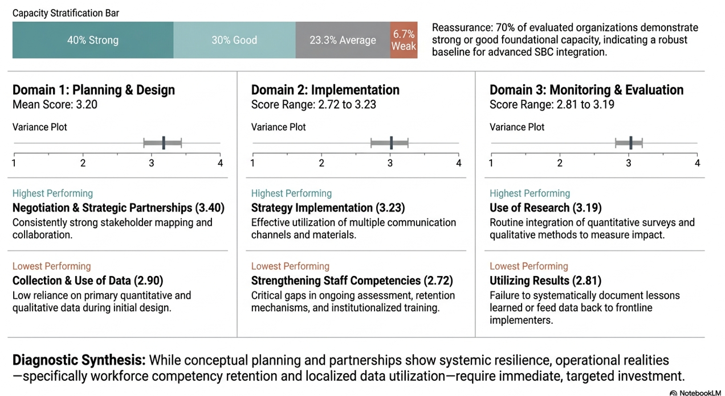
www.ehepa.org
Notes:
Overall Capacity Assessment (N=30 Organizations): Strong (40.0% (12 orgs)), Good (30.0% (9 orgs)), Average = (23.3% (7 orgs)), and Weak (6.7% (2 orgs))
Key Finding: The majority of assessed organizations demonstrate solid SBC capacity, with 70% rated as Good or Strong. However, nearly a quarter (23.3%) remain at average capacity, and a small fraction (6.7%) still struggle with basic SBC programming.
Mean Scores Across 3 SBC Capacity Domains: Domain 1: Planning & Design (3.20 / 5.00); Domain 2: Implementation (3.23 / 5.00); & Domain 3: M&E (2.81–3.19 / 5.00).
Interpretation: Planning & Design = Frameworks exist but standardization is weak; Implementation = Moderate capacity; multi-channel approaches widely used; and M&E = Behavioral outcome measurement is the weakest link.

Slide 35
Key Lessons Learned from SBC Implementation Study
Strengthening SBC Systems
Participatory Design → Engage communities and stakeholders.
Robust M&E → Use strong tools to measure behavioral outcomes.
Sustainable Financing → Ensure dedicated long‑term funding.
Institutional Partnerships → Build collaborations for continuity; outlast short-term project partnerships.
SBC is more effective when it is collaborative, well-monitored, sustainably financed, and institutionally supported.
www.ehepa.org
Notes:
Emphasize that SBC systems thrive when design, monitoring, financing, and partnerships are integrated. Link this to Ethiopia’s multi‑sectoral framework.
Explain that these lessons align with global SBC frameworks and Ethiopia’s policy priorities.
Seven Key Lessons Learned
Participatory design drives/enhances community ownership and program relevance.
M&E must measure BEHAVIOR, not just activities and outputs.
SBC needs independent, sustainable financing — not just project budgets.
Institutional partnerships outlast short-term project partnerships.

Slide 36
Key Lessons Learned ...
Driving Sustainable Impact
Advocacy & Leadership → Secure commitment from decision‑makers.
Capacity Building & Innovation → Invest in HCD and Behavioral Economics. Cascading Training.
Harmonization & Knowledge Sharing → Standardize materials and promote learning.
Strong leadership, continuous learning, and coordinated efforts are essential for sustainable SBC impact.
www.ehepa.org
Notes:
Explain that sustainability depends on leadership engagement and continuous learning. Use examples from UNICEF and MOH collaborations.
5. Advocacy and leadership engagement are prerequisites for SBC success.
6. Capacity building must include HCD, behavioral economics, and digital tools. Continuous capacity building sustains quality.
7. Harmonize materials and share knowledge nationally to avoid/prevent duplication.

Slide 37
Conclusion
Ethiopia’s SBC ecosystem stands at a strategic crossroads.
Strong SBC capacity exists across organizations, supported by technical expertise and community engagement approaches.
However, systemic barriers persist.
CSOs, FBOs, and CBOs → play vital roles in community mobilization and innovation but face sustainability and integration challenges.
M&E systems remain weak, with limited measurement of behavioral outcomes.
Progress depends on embedding SBC within sustainable, locally owned structures.
Sustainable SBC impact requires institutionalization, long-term financing, and stronger coordination among government, CSOs, FBOs, and CBOs.
www.ehepa.org
Notes:
Summarize the dual reality: strong technical capacity but fragile systems. Transition smoothly to recommendations.
Conclusion: Toward a Sustainable SBC System
Moving from fragmented donor-driven activities to a robust, institutionalized, and locally-owned system in Ethiopia.
Strategic Roadmap to 2026 Transformation
Current Status: Fragmented & Donor-Dependent - Project-based implementation with limited coordination.
Institutionalization: Unified National Strategy - Dedicated domestic budget lines and integrated governance.
SBC Summit 2026: Consolidating Local Ownership - A milestone for sustainable, coordinated systems by June 2026.
Future Vision: Evidence-Based Transformation - Self-sustaining ecosystem driven by community structures.
Key Transformation Drivers: By integrating behavioral indicators into national systems (HMIS/DHIS2) and empowering multi-sectoral technical working groups, Ethiopia will transition toward a system where SBC is financed and led by government and community structures.
Reinforce the message that SBC must move from fragmented projects to institutionalized systems for lasting impact.

Slide 38
Recommendations
Ethiopia’s SBC ecosystem needs coordinated action in six areas:
Institutionalize SBC: Establish dedicated SBC structures & clear ownership.
Ensure Sustainable Financing: Increase domestic funding/create a dedicated SBC budget line.
Strengthen Capacity & Leadership: Expand SBC/HCD training, integrate SBC into curricula, and promote leadership engagement.
Enhance Monitoring & Research: Standardize indicators & strengthen evidence generation and learning.
Improve Coordination & Community Engagement: Strengthen multi-sectoral collaboration and community participation.
Leverage Technology & Innovation: Utilize digital tools, centralized databases, & evidence-based approaches.
www.ehepa.org
Notes:
Tailored Recommendations by Audience (Present actionable recommendations for each stakeholder group. Encourage collaboration and accountability.)
For Policymakers & Ministry of Health (Action, Priority, and Rationale)
Establish a dedicated SBC unit within the MOH (High priority) - Institutionalize SBC leadership
Embed SBC indicators into DHIS2 and national health information systems (High priority) - Close the M&E gap
Allocate 8–12% of program budgets to SBC activities (High priority) - Address chronic underfunding
Develop a national SBC strategy and M&E framework (Medium priority) - Standardize practice
Create a national SBC network or community of practice (Medium priority) - Share knowledge and reduce duplication
For Program Managers & Implementers (Action, Priority, & Rationale)
Adopt Human-Centered Design (HCD) as standard practice (Medium Priority - Improve program relevance
Pretest all SBC materials before scale-up (Medium Priority) - Ensure cultural appropriateness
Integrate SBC behavioral indicators into routine M&E (High Priority) - Move from output to outcome measurement
Use and support community volunteers (health development armies, mobilizers), Medium Priority, - Sustain community-level activities
Preposition SBC materials and job aids at all levels (Medium Priority) - Ensure access to quality tools.
For Partners & Donors (Action, Priority, & Rationale)
Shift from project-based to institution-based partnerships (High Priority) - Build long-term capacity
Fund operational research on SBC effectiveness (Medium Priority) - Generate local evidence
Support a national SBC resource bank (materials, tools, training) (Medium Priority) - Reduce duplication
Support digital platform adoption for SBC (Medium Priority) - Expand reach and engagement
Fund core SBC staffing and systems, not just campaigns (High Priority) - Enable sustainable programming.
Government Ministries: Institutionalize SBC, integrate indicators, secure financing. Implementing Partners: Harmonize materials, invest in outcome‑focused monitoring. Professional Associations (EHEPA): Lead training, certification, and quality assurance. Community Structures: Strengthen local platforms and participatory planning.

Slide 39
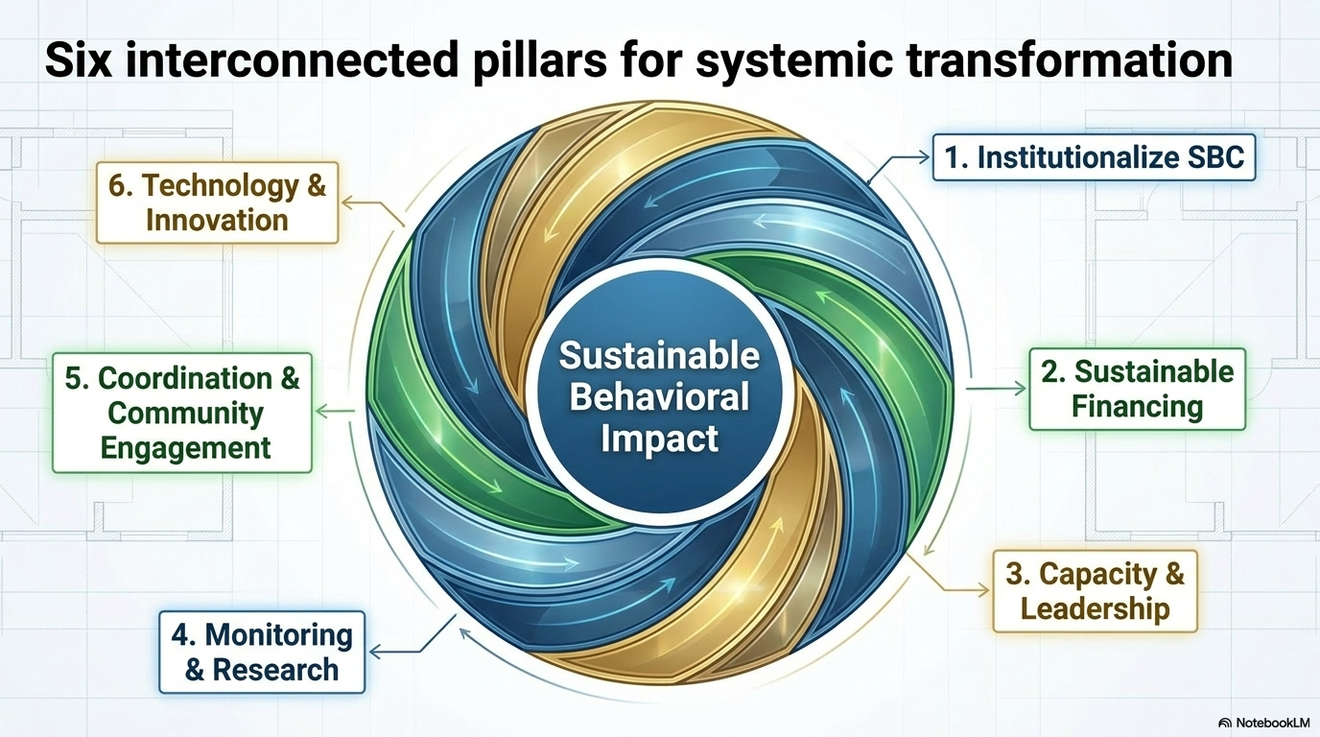
www.ehepa.org
Notes:
Explain that sustainability depends on leadership engagement and continuous learning. Use examples from UNICEF and MOH collaborations.
Introduce the six pillars as the roadmap for system transformation. Each will be elaborated in the next slides. Use animation to reveal each recommendation sequentially. End by emphasizing that these actions require joint commitment from government, partners, and communities. Implementing partners should transition from standalone interventions toward integrated system strengthening to ensure the sustainability of Social and Behavioral Change (SBC) outcomes in Ethiopia. Transitioning from passive observers to active regulators and capacity builders. By June 2026, the SBC Learning Central will serve as the primary engine for institutionalizing quality standards.
Core Strategy for Empowering Community Structures: Transitioning from Passive Participation to Local Ownership - The strengthening of grassroots platforms—including youth clubs, women’s groups, and religious institutions, is essential for the institutionalization of Social and Behavior Change (SBC) in Ethiopia. By integrating these structures into formal systems, we ensure sustainable, community-led impact.
Close with a forward‑looking message: this transformation is achievable through collective commitment and evidence‑based action.

Slide 40




Acknowledgements
We Grateful for: Study participants and organization, data collectors!
Funding
Ethics Review
For support
Dissemination Workshop | June 25, 2026
Capacity, Barriers, and Enablers of SBC Implementation
www.ehepa.org
Notes:
Open by explaining that this section distills practical insights from field experiences and interviews, the “how” behind successful SBC implementation.
Thank all collaborators and emphasize the shared vision for strengthening SBC systems in Ethiopia.

Slide 41
THANKS!
Building Robust SBC Systems!
www.ehepa.org
Notes:
End with appreciation and invite discussion. Encourage participants to reflect on how these best practices can be adapted within their own institutions.

