Slide 1


Behavioral Insights for School Transformation: From Research and Community Co-Creation Workshops to SBC Strategy Implementation in South and Southwest Ethiopia
Evidence
Co-creation
SBC Strategy
Implementation
by
Tizita Dengia
Monitoring and Evaluation
June 05, 2026
1

Slide 2
Outline of Presentation
1
Why Behavioral Insights (BI) study?
2
BI study evidence
3
Co-creations
4
Connecting local action plans to policy frameworks
5
Social and behavior change (SBC) strategy
6
Key takeaways
2

Slide 3
Behavioral Insights Study on Community Engagement and School Ownership for Improving Learning Outcomes, Designing Strategies, and School Planning/Visioning in Six Primary Schools Across South and Southwest Ethiopia Regions
3

Slide 4
Why was there a need to conduct the BI study?
Ethiopia expanded access to primary education, but access has not translated into quality learning outcomes.
Reforms such as GEQIP-E and School Improvement Program (SIP) were already in place, but pedagogy and formal structures alone were not enough.
Sustainable improvement requires community engagement, school ownership, and accountability
Learning crisis
90%
of 10-year-old children cannot read and understand a simple text
(EAES, 2023)
Access increased
Learning remained low
Engagement needed
BI study response
4

Slide 5
The "Intention-Action Gap"
Community structures existed, but there was low parental involvement, weak accountability, and limited community ownership.
Limited engagement
Capacity & information gaps
Equity gaps
No BI lens
Community representatives lacked training to interpret student performance data, or hold schools accountable.
Parents received limited child-friendly information on whether children are learning.
Local leaders, wealthier families, or politically connected individuals dominated decision-making, excluding women, poorer households, and caregivers of CwD.
Current reforms have not fully embedded behavioral and social insights (e.g., norms, cognitive biases, trust) into their design.
PTSAs often focused on mobilizing money, labor, or materials.
Less focus was placed on teaching quality, learning outcomes, or school improvement planning.
Parents valued education but fail to engage in learning
The study was needed because improving learning outcomes required understanding the behaviors, norms, trust, aspirations, and accountability relationships that shape parental and community participation.
5

Slide 6
Objective of the study
General objective
Generate evidence-based insights and propose behavioral solutions that enhance community engagement and school ownership, contributing to improved foundational learning and inclusive school planning, in South and Southwest Ethiopia.
Specific objectives
Explore community perceptions, attitudes, and intentions regarding children's learning outcomes and school governance
1
2
Identify existing community engagement platforms and channels (both formal and indigenous) that can be leveraged.
3
Examine behavioral, normative, and structural barriers and facilitators to school ownership.
3
4
Explore aspirations and barriers facing girls, poorer households, and caregivers of children with disabilities
5
Design tailored Social and Behavioral Change (SBC) solutions that address identified barriers and promote inclusive, sustainable engagement.
6

Slide 7
Methods
Study design
Study participants and data collection
Qualitative study with participatory elements, framed by the Socio-Ecological Model (SEM) : (individual, interpersonal, community, institutional, policy levels)
Woreda education officials including special needs focal persons, school leaders, supervisors and community leaders
KII
IDI
Parents/caregivers, including CwD, girls, out-of-school, high/low performing learners
Study sites & period
FGD
Parents, elders and PTSA members
Six primary schools across Konso (Addis Gaberie Primary School), South Omo (Kerkele, Kuraz and Mermerte Primary Schools ) and West Omo (Genet Era and Gayy Primary Schools ) zones; data collected June 24–July 4, 2025.
Children’s drawings, visioning and diary-based exercises
Participatory tools
Observation
Learning environments, school meetings and participation activities
Sampling: Purposive
Data analysis: Thematic analysis
7

Slide 8
Results: The Behavioral Diagnosis
Barriers
Facilitators
Individual
Limited know-how to support learning; fatalism; girls’ menstruation-related absenteeism; CwD lack assistive support.
High aspirations for professional futures; education seen as dignity, independence and family honor.
Interpersonal
Household labor, gendered domestic burdens and peer norms weaken follow-up after enrollment.
Parent-to-parent influence, mother circles, girls’ clubs and model families can normalize learning support.
Early marriage, stigma and pastoralist/agricultural routines compete with school participation, “school belongs to the government” mindset
Elders, religious leaders, kebele structures, indigenous forums and Parents’ Day are highly trusted channels.
Community
Institutional
PTSA meetings perceived as fundraising; shortages of teachers, textbooks, classrooms, water and inclusive facilities; no structured forum for parent feedback
PTSA/kebele home visits, school feeding, local-language instruction, public recognition and transparent reporting build trust.
Policy
National equity/accountability frameworks are inconsistently resourced and operationalized locally.
GEQIP-E/SIP, woreda support, NGO partnerships and social protection can sustain school ownership.
8

Slide 9
Results: The Behavioral Diagnosis
Motivation was present, but not yet converted to practice
Common patterns across the six schools
Communities want education to work, but they sustain engagement only when schools are trusted, responsive and visibly improving.
Barriers to solve
Facilitators to leverage
Girls face early marriage, work burden and menstrual hygiene barriers
Children with disabilities face stigma and weak institutional support
PTSA viewed as a "tax collector" not a "learning partner“
Resource gaps weaken trust: classrooms, textbooks, WASH, teacher capacity
Parents often lack practical ways to support learning at home
No structured forum for parent feedback
Livelihood calendars shape education behavior: farming, herding interrupt attendance
Parents aspire for children’s success and dignity
Trusted elders, religious leaders and local networks carry credibility
Peer families and role models can create positive social contagion
School feeding, mother-tongue support and inclusive practices motivate attendance
9

Slide 10
The “translation gap”: evidence must become a doable behavior
Finding
Behavioral driver
Target behavior
Support design
Action plan
Parents value education but rely on child labor during busy periods
Local leader dialogue + parent tip card + peer family role model
Named owner, monthly forum, school/PTSA tracking
Immediate household needs overpower future learning benefits
Reduce work pressure during school days; check child’s materials weekly
10

Slide 11
Behavioral solutions
Individual & family
Interpersonal
Community
Institutional
Policy
Equip parents & children with knowledge, tools, and motivation
Children set learning goals
Role-model stories (educated community members)
Strengthen family and peer support
Girls’ peer clubs
“Parent of the Term” & “Learning Champions” recognition
Family mentorship
Leverage trusted local structures & norms
Engage elders/religious leaders with sermon scripts, dialogue guides
Use indigenous forums for dialogues on child marriage, disability stigma and work pressure
Parents’ Day festivals with transparent reporting & public recognition
Improve governance, accountability, and learning environment
Reframe PTSA agendas: from fundraising to learning outcomes & pedagogy
Joint home visits by PTSA + kebele leaders to track dropouts
Create enabling conditions through systemic support
Institutionalize inclusive education policies (ramps, assistive devices, teacher training on CwD)
EASY
ATTRACTIVE
SOCIAL
TRUSTED
TIMELY
11

Slide 12
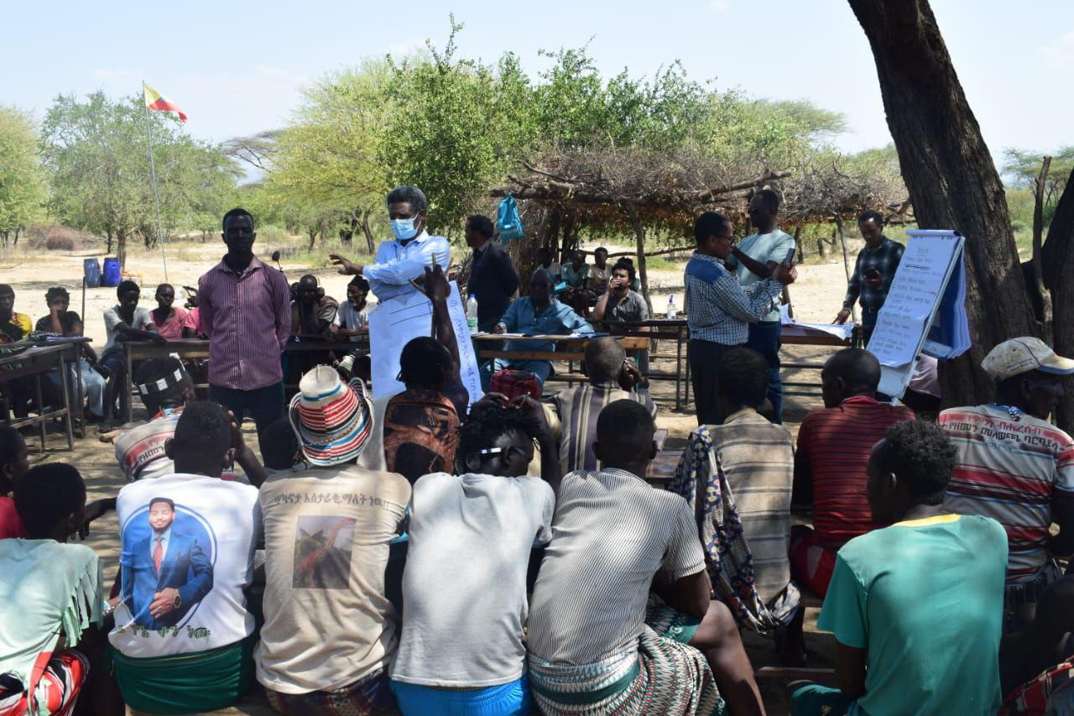
Co-creation: the bridge from evidence to action
Co-creation with communities
The workshop was conducted to validate findings, build shared understanding, generate practical ideas, prioritize what matters most, and empower all voices in solution-building.
40 participants per school
2 days per site
Participants included PTSA members, students, teachers, principals, WEO representatives, religious/clan leaders, women/youth groups, health extension workers, and representatives of people with disabilities.
Co-creation workshops made the evidence trustworthy, local and implementable
12

Slide 13
Co-creation workshop process (participatory co-design)
1
Present study findings
2
Vignette + reflection
3
Shared vision
Empathy + lived experience
Common evidence base
4
List barriers
5
Rank barriers (2 lenses)
6
Consolidate + prioritize
What blocks the vision?
Ease of implementation & importance
Transparent scoring
7
Classify problem areas
8
Co-create action plans
Behavior vs environment
Who does what, when?
14

Slide 14
Barrier prioritization: combining “importance” + “feasibility”
Two mixed groups applied two lenses to the same barrier list:
Lens A: Feasibility/ease
Consolidated output
Rank barriers from easier → harder
Very important + Easy to implement
Very important + Hard to implement
Resources required
Technical complexity
Time needed
Lens B: Priority / importance
Less important + Easy to implement
Less important + Hard to implement
Rank barriers from very important → less important
Expected impact on the vision
Benefits to users
Alignment with priorities
15

Slide 15
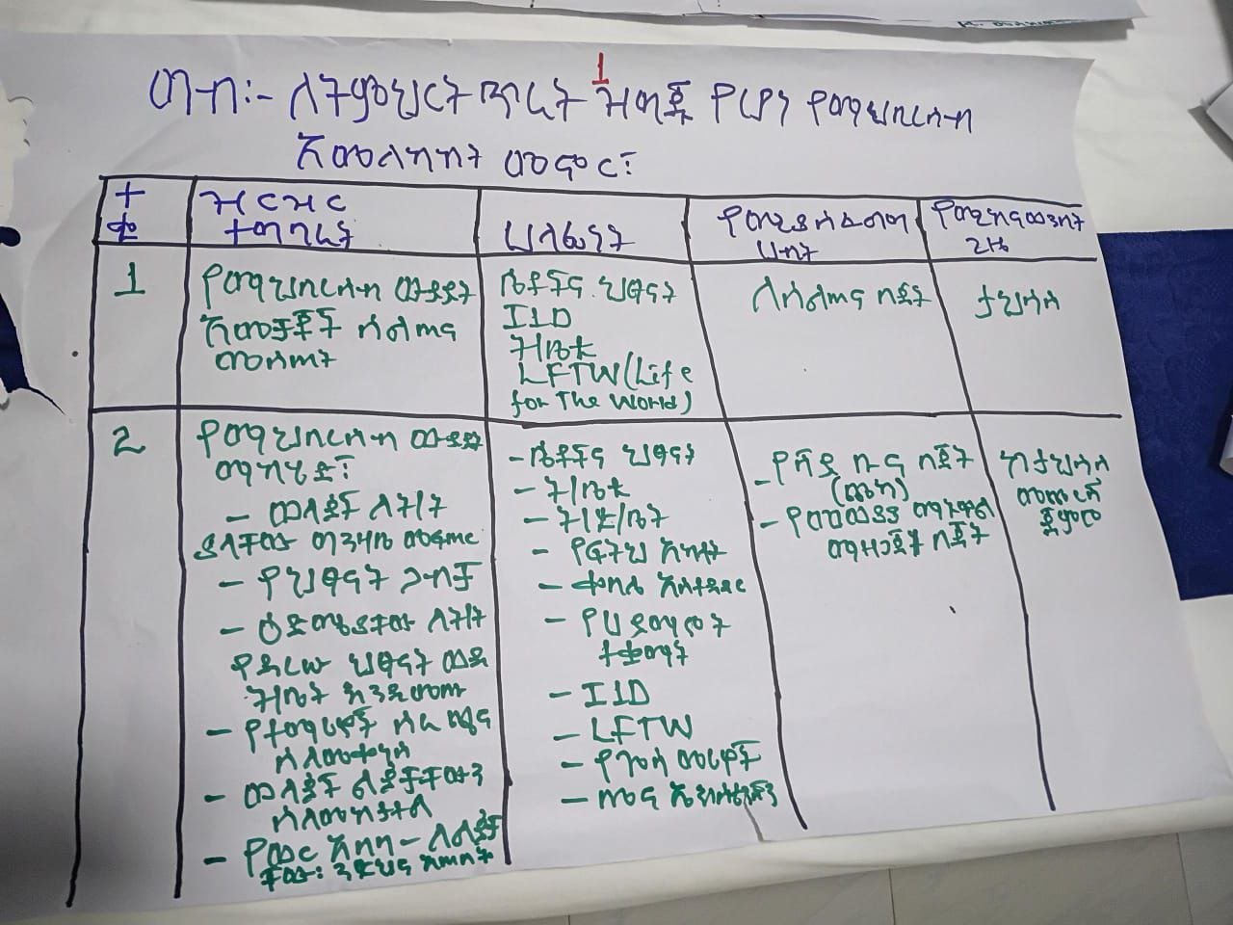
Turning priorities into action plans
Final prioritized barrier list
Behavior-related
problem areas
Environment-related
problem areas
Action plan
• Activities
• Responsible persons
• Timeline
• Needed resources
Action plan
• Activities
• Responsible persons
• Timeline
• Needed resources
16

Slide 16
Human‑Centered Design (HCD) approach
Empathize
and Validate
Vignettes checked whether findings matched realities; stories helped stakeholders see different actors’ constraints
Define and Prioritize
Visioning exercise; listing barriers & facilitators; ranking problems by importance and ease
Ideate
Jointly generated practical solutions
Prototype
Tasks, resources, and timeline agreed: co-developed action plan
Commit
Local ownership and monitoring
13

Slide 17
What was co-created: barriers converted into actions
Co-creation translated each barrier into a school-owned action with named actors, resources, and dates.
LEVEL
PRIORITIZED BARRIERS
CO-CREATED SOLUTIONS
Individual & family
Low parent knowledge on how to support learning; work pressure on children; girls’ MHM needs.
Peer discussions, parenting skills, visual progress tools, material support, MHM materials.
Interpersonal
Weak home follow-up, peer norms, early marriage, disability stigma.
Mother/girls’ groups, role-model recognition, family follow-up, student peer facilitators.
Community
Pastoralist labor cycles, harmful practices, low collective accountability.
Community conversations led by trained facilitators, elders, religious/clan leaders, and clubs.
School / institutional
Teacher capacity gaps, weak PTSA roles, poor monitoring, limited learning materials.
Teacher CPD, PTSA role training, monitoring systems, textbooks, assessment strengthening.
Structural / environment
Shortage of classrooms, water, toilets, ramps, MHM rooms, disability materials, school fencing.
Inclusive classrooms/toilets, ramps, clean water, libraries, fences, assistive devices, computers.
17

Slide 18
Connecting local actions to policy frameworks: School Improvement Plan (SIP) Mapping & Standards
Co‑created actions were aligned with national SIP standards – ensuring legitimacy and sustainability.
Each activity from the workshop was mapped to the four SIP domains and their standards while retaining local specificity.
Teaching & learning
Learning environment
Teacher capacity, local language support, assessment methods, textbooks and supplementary books.
Classrooms, water, separate/inclusive toilets, ramps, MHM rooms, assistive devices, fences.
School leadership
Community participation
PTSA strengthening, shared monitoring, principal/supervisor follow-up, community–school communication.
Monthly dialogues, school clubs, peer-to-peer sessions, recognition events, resource mobilization.
18

Slide 19
Social and Behavior Change (SBC) strategy: the implementation engine from co‑created plans to behavioral change
The strategy operationalized each School Improvement Plan by targeting the behavioral drivers behind learning, attendance and school ownership.
Core strategy logic
SBC provides:
✅ Clear behavioral objectives
✅ Audience segmentation
✅ Tailored messages and channels
✅ Monitoring & evaluation
Who changes?
What changes?
Parents, students, teachers, PTSA, elders/religious leaders, WEO
Follow-up, attendance, girls’ retention, disability inclusion, material support, trust and accountability
How it changes?
What it produces?
Trusted messengers, local-language dialogue, peer clubs, edutainment, visible recognition and quarterly reviews
Greater school ownership, reduced absenteeism, stronger learning support and progress toward literacy/numeracy visions
19

Slide 20
SBC strategy operationalized the SIP by defining audiences, behaviors, channels, messengers and reinforcement
Reinforcement
Audience
Behavior
Channel
Parents/caregivers
Students
Teachers
PTSA
Leaders
Follow up learning
Reduce work burden
Support girls & CwD
Attend forums
Community dialogue
Peer-to-peer clubs
Mini-media
Religious/elder forums
Recognition events
Quarterly reviews
Monitoring by PTSA
Feedback loops
20

Slide 21
SBC Packages
Advocacy + community mobilization + peer change + recognition
Action package 1: Community mobilization
Target: Parents, elders, clan/religious leaders
Community dialogue shifts norms and expectations
Trusted local messengers make education behavior socially legitimate
Topics addressed
Messengers
Why it works
• Child/early marriage
• Work pressure on students
• Parental follow-up
• Girls’ MHM and dignity
• Disability stigma
• School-age children not in school
• Religious leaders
• Clan/elder leaders
• Women & children affairs
• Health/agriculture extension
• PTSA and school leaders
• Uses existing trust
• Makes positive behavior visible
• Creates shared expectations
• Links family action to learning vision
Activity example: Monthly community conversations on early marriage, FGM, and work pressure
21

Slide 22
Action package 2: Student-led change inside the school/school‑based social change
Train peer facilitators
Activate school clubs
Life skills, child marriage, MHM, disability inclusion and learning motivation
Gender, mini-media, health and environmental clubs create repeated touchpoints
Weekly discussions
Recognition
Small repeated conversations normalize the expected behaviors
Top performers and contributors receive public acknowledgement
Activity example: Weekly peer‑to‑peer discussions led by Gender and Mini‑media clubs
22

Slide 23
Action package 3: Social proof and incentives
Target: All community members
Tactic: “Positive deviance recognition” – public awards for model parents and students
Activity example: Annual role model festival and semi‑annual recognition
23

Slide 24
Action package 4: Advocacy
Target: Kebele leaders, Woreda officials, religious leaders
Tactic: “Peer‑to‑peer advocacy” – respected leaders influence hesitant ones
Activity example: Engaging Kebele Chairman and religious leaders to champion learning materials
24

Slide 25
School-level tailoring
Behavioral / structural bottleneck
Action translation
School
Materials, work pressure, disability stigma, MHM
Parent dialogue, peer discussions, sanitary pad training, recognition
Addis Geberie
Dhimmi, child marriage/FGM, language barriers, cattle herding
Community dialogue, Dasenech language support for teachers, PTSA monitoring
Mermerte
Kuraz
Parenting skills, PTSA role training, clubs, quarterly review
Low motivation, weak parent-school relationship, water/heat stress
Parental follow-up, weak PTSA, teacher monitoring, child marriage
Community conversations, teacher follow-up, peer life skills, annual recognition
Genet Era
Gayy
Mining migration, child marriage, teacher/special needs gaps
Community dialogue, special needs materials, school feeding/MHM support
25

Slide 26
Implementation architecture: who converts the plan into action?
School & teachers
PTSA
Community leaders
Government offices
Partners
Classroom practice
Student clubs
Teacher monitoring
Parent follow-up
Resource mobilization
Quarterly review
Dialogue facilitation
Norm shifting
Education, women/children
I1D, LFTW, UNICEF
Materials, training
Implementation support
26

Slide 27
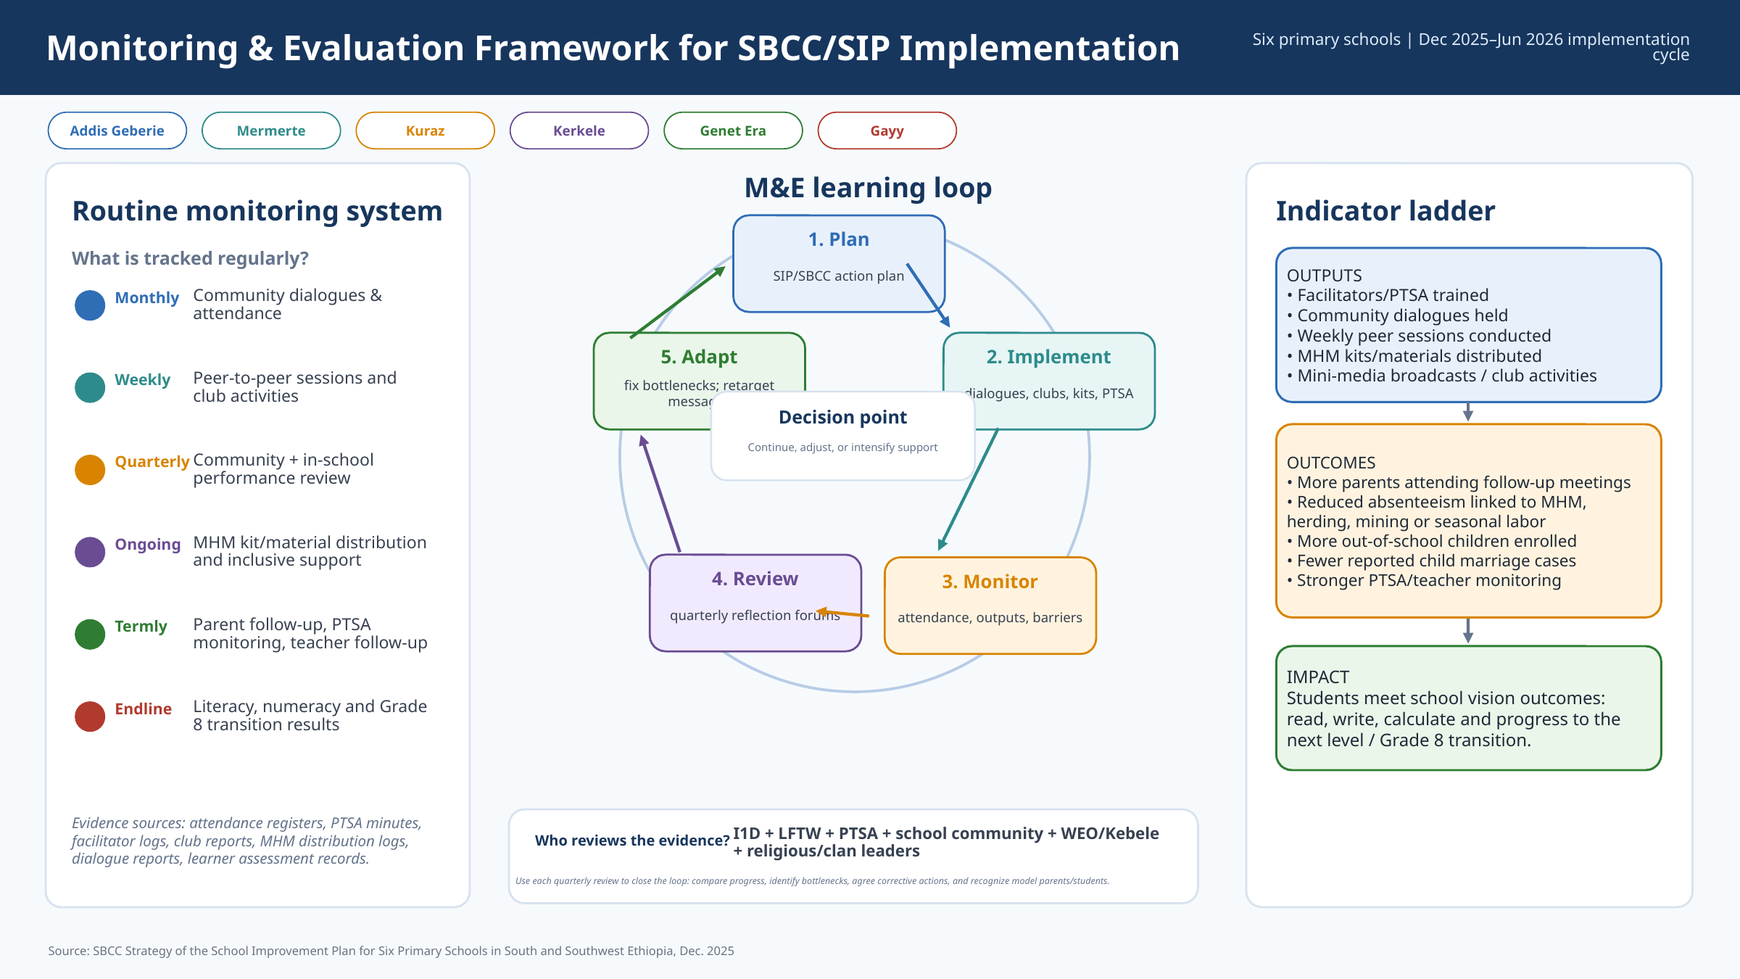
Monitoring & Evaluation: track action, behavior and learning pathway
Training manuals
Facilitators trained
Materials supplied
Inputs
Facilitators/PTSA trained
Community dialogues held
Weekly peer sessions conducted
MHM kits/materials distributed
Mini-media broadcasts / club activities
Outputs
More parents attending follow-up meetings
Reduced absenteeism linked to MHM, herding, mining or seasonal labor
More out-of-school children enrolled
Fewer reported child marriage cases
Stronger PTSA/teacher monitoring
Parents provide materials
Inclusive practices
Outcomes
% of students meeting literacy/numeracy aligned with each school vision (read, write, calculate); progress to the next level
Impact
27

Slide 28
Key takeaways
Evidence is the starting point: BI diagnosis must translate into clear behaviors: who does what, when, where, and with what support.
Evidence becomes useful when communities validate it, prioritize it, and turn it into owned action.
Co-creation builds trust and ownership.
SBC strategy operationalizes action.
Leverage what already works: Elders, religious leaders, indigenous forums are more trusted than formal letters. Use existing platforms (Parents’ Day, women’s groups, school clubs) to deliver SBC messages
Implementation must be learned: Track activities, behavior shifts, inclusion, attendance, and literacy/numeracy progress through regular feedback loops.
29

Slide 29
"Supporting school is like supporting my own home. My child's future fruitfulness depends on my contribution."
              (Female Parent, Kerkele Primary School)
28

Slide 30
Thank you!
30

