Slide 1

Behavioral, Social and Structural Drivers of HPV Vaccine Uptake and Parental Confidence Among Out-of-School Adolescent Girls in Ethiopia Findings from Afar, Benishangul-Gumuz, Gambella, and Somali Regions
Presenter: Takele Gezahegn (MPH, Assistant Prof.)
Project officer at EHEPA
06 March 2026
Addis Ababa, Ethiopia

Slide 2
Outlines
Background/Rationale
Objectives
Methods
Results/Discussion
Conclusion/Recommendations
Acknowlegdement

Slide 3
Introduction (1/3)
Global & Ethiopian burden
Cervical cancer: 4th most common globally (>570,000 new cases annually) (Derbie et al., 2023; Kisa & Kisa, 2024)
Ethiopia: the 2nd most fatal cancer among Ethiopian women
incidence 22.4/100,000, higher than global average (GCO, 2025)
HPV prevalence: 17.3% overall, 15.8% high-risk types (Derbie et al., 2023)
HPV as a leading cause of cervical cancer
HPV vaccine plays a crucial role in the global fight against cervical cancer
Despite >6.3M doses since 2018, vaccine uptake remains suboptimal (Gavi, 2024)

Slide 4
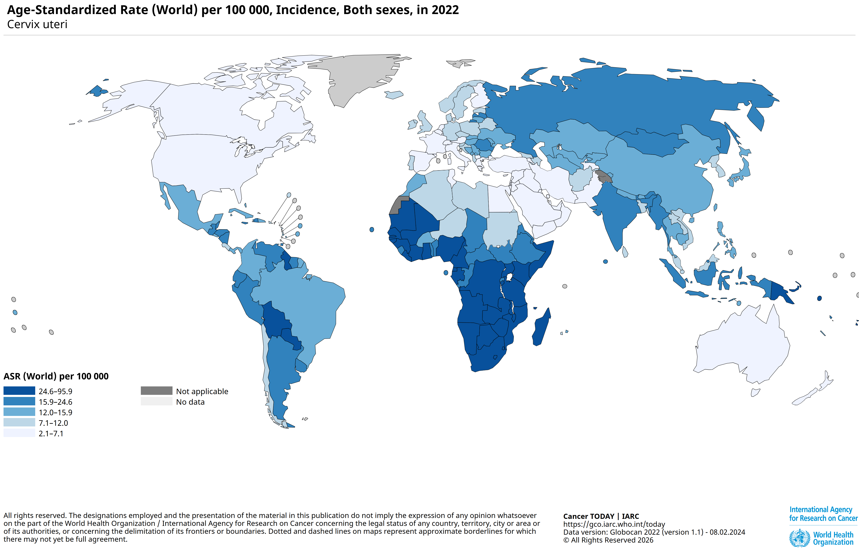
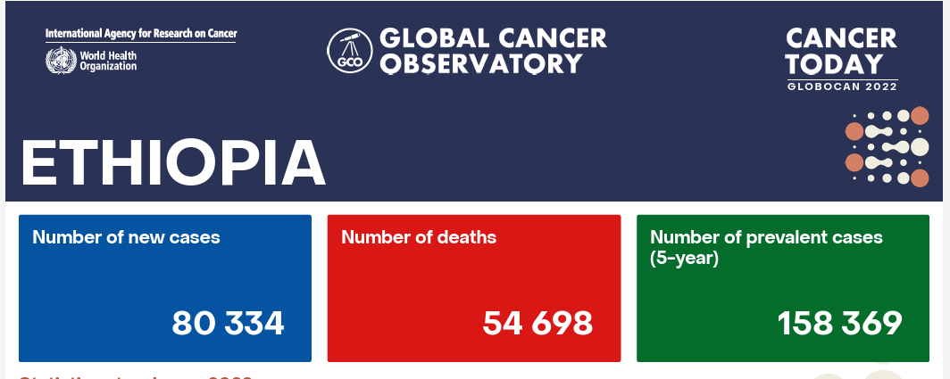
Introduction (2/3)
https://gco.iarc.who.int/today/en/dataviz/pie?mode=cancer&types=0&sexes=2&populations=231

Slide 5
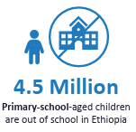
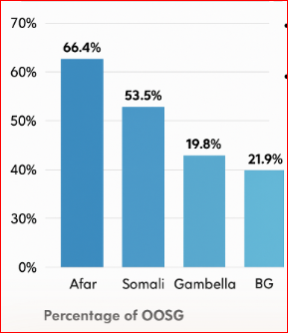
Introduction (3/3)
Out-of-School Girls & Equity Challenges
4.5M primary-school-aged children out of school (MOE, 2020)
Highest out-of-school girls (OOSG) rates: Afar (66.4%), Somali (53.5%), Gambella (19.8%), BG (21.9%) (Hailemariam et al., 2021; Zepro et al., 2023)
Barriers: sociocultural stigma, gender norms, religious beliefs, Misinformation, Decision-making autonomy;
Over 60% of women require male consent to access healthcare (Zepro et al., 2023)
Parental confidence and caregiver decision-making are critical determinants
EquityChallenge: OOSGs

Slide 6
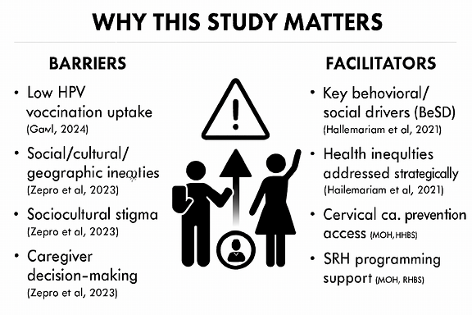
Why This Study Matters (Rationale)
Willingness to uptake HPV vaccination was found to be low (Derbie A, et al., 2023)
HPV vaccine coverage still below WHO’s 90% target by 2030 (WHO, 2023)
Unique barriers in underserved regions require tailored strategies (Hailemariam et al., 2021)
This study identifies behavioral & social drivers (BeSD framework) and parental confidence factors
Support MOH, RHBS, and local leaders in strengthening SRH programming

Slide 7
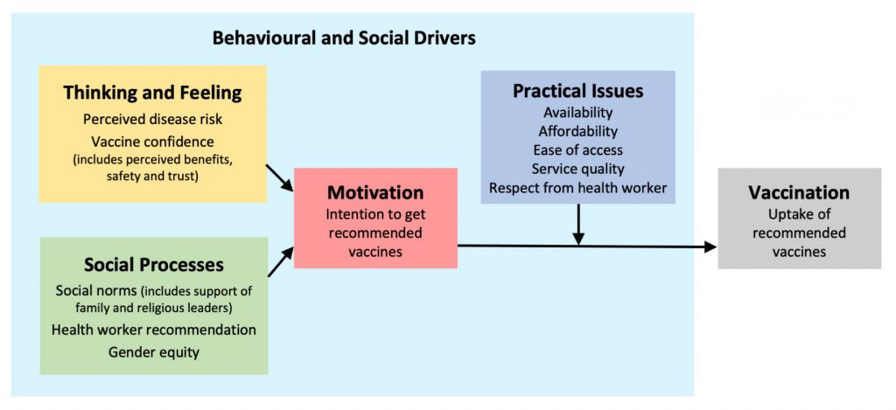
Conceptual Framework: The Behavioral and Social Drivers (BeSD) of vaccination framework
WHO BeSD domains: confidence, motivation, social norms, decision-making autonomy, service delivery experiences
WHO (2022) Based on Brewer et al. Psychol Sci Public Interest. (2017).

Slide 8
General Objective
Aimed to assess behavioral, social, and structural factors influencing HPV vaccine uptake and parental confidence among out-of-school adolescent girls in Ethiopia

Slide 9
Specific Objectives
Determine the prevalence of HPV vaccine uptake among out-of-school adolescent girls aged 9–14 years
Examine levels of confidence in HPV vaccine safety and benefits among parents/caregivers
Identify behavioral and social drivers (motivation, risk perception, trusted sources, decision-making autonomy) influencing HPV vaccine uptake
Explore structural and service delivery factors (availability, consent procedures, documentation, access points) affecting HPV vaccination
Analyze factors significantly associated with HPV vaccine uptake and parental confidence

Slide 10
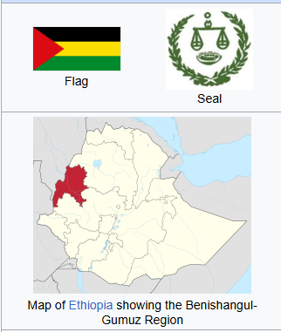
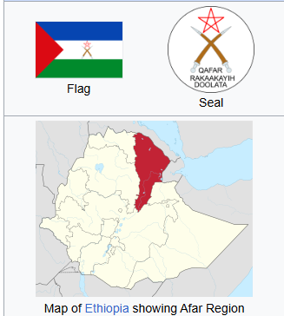
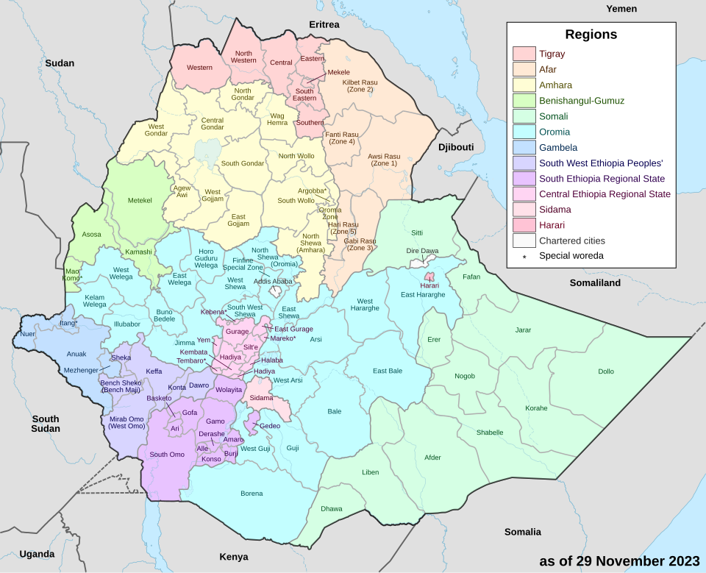
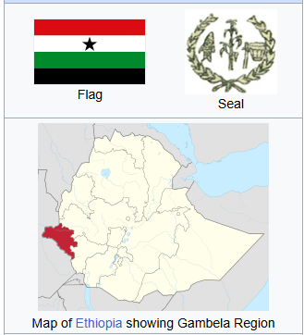
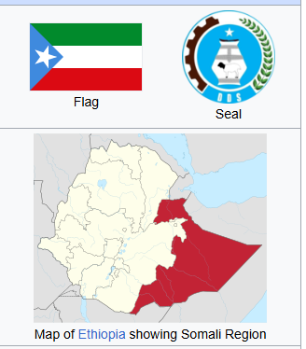
#08 Selected Zones
Methods
Study areas: was conducted in 4 regions
Note: underserved, hard-to-reach populations
Design: Community-based cross-sectional study using WHO BeSD framework
Period: August 14–31, 2025
https://en.wikipedia.org/wiki/Regions_of_Ethiopia
Notes:
Show the geographic scope, explain why these regions were chosen (equity, underserved populations, out-of-school girls).

Slide 11
Target Population & Sampling Criteria
Source population: All OOSAGs aged 9 to14 years in the target regions
Study population: Randomly selected OOSAGs aged 9 to14 years and their parents/caregivers
Inclusion criteria
OOSAGs aged 9 to14 years old and their parents/caregivers
Those who are willing to participate in interviews
Residents in the target geographical regions at least for 6 months were included.
Exclusion Criteria
OOSAGs aged 9 to14 years old and their parents/caregivers who are unable to unavailable/critically sick
Sample size: = Sample: 693 out-of-school adolescent girls (9–14 years) and caregivers determined by single population proportion formula
Sampling technique: Multistage sampling method

Slide 12
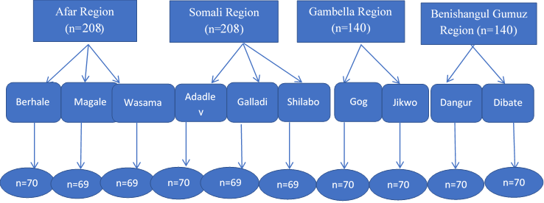
Sampling Strategy for OOSAGs & Caregivers
Stratified by region: Afar & Somali (60%), BG & Gambella (40%)
Proportional allocation: 208 each from Afar & Somali; 140 each from BG & Gambella
Woredas selected based on low HPV coverage and high OOSAG numbers
Random household selection; one girl + one caregiver per household (MOE, 2020; Hailemariam et al., 2021)

Slide 13
Study Variables & BeSD Framework
Dependent:
HPV vaccine uptake,
Parental confidence
Independent:
Sociodemographic charactersitscs
Thinking and Feeling
Motivation
Social norms/processes
Practical issues
Framework:
WHO BeSD adapted for local context (Zepro et al., 2023; WHO, 2023)
Notes:
Independent variables based on the BeSD framework:
Sociodemographic charactersitscs: age, region, family composition, educational status, disability status
Thinking and Feeling: Awareness, perceived disease risk; vaccine confidence, including perceived benefit, safety, and trust.
Social processes: Social norms (including support from family, peer, teachers, and religious leaders), and health worker recommendation
Motivation: Intention to receive recommended vaccines and decision-making automnomy
Practical issues: Availability, affordability, ease of access, service quality, and respectful treatment by health workers

Slide 14
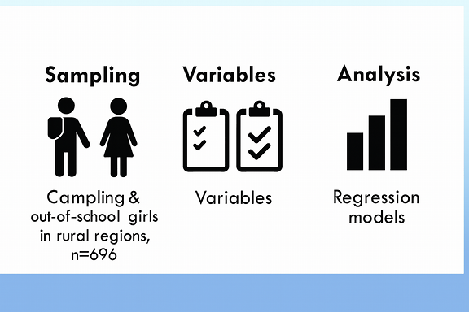
Data Collection & Analysis
Tools: BeSD survey via KOBO; validated & translated
Quality: Training, Questionnaire items review/ clarification, Daily supervision, completeness checks
Analysis: Stata v17; descriptive stats + logistic regression
Model fit: Hosmer–Lemeshow test; p < 0.05 significance (Hailemariam et al., 2021; Derbie et al., 2023)

Slide 15
Ethical considerations
Ethical clearance: Secured from EPHA
Official permissions: MOH, RHBs, Zonal & district health offices
Written Consent: Obtained from parents/caregivers for minors
Assent: Obtained from out-of-school adolescent girls aged 9–14
Voluntary participation: Right to withdraw anytime
Confidentiality: Data collected and analyzed anonymously

Slide 16
Results/Discussion
Sociodemographic Characteristics of Adolescent Girls
693 participants (response rate 99.6%)
Largest share from Somali and Afar (30% each)
Age: 51.4% late adolescents (12–14
58.3% had attended school at least once;
46.6% never attended formal school
Majority engaged in household work (75.8%)
Most lived with parents/siblings (95.1%)
SD Characteristics of Parents/Caregivers
Similar with that of OOSAG
Median age: 35 years (range 18–83)
Majority female (87.3%), mostly mothers (80.8%)
70% had no formal education
40% had two/more adolescent girls aged 9–14 in their household
Notes:
Highlight the vulnerability of this group: many never attended school, most are confined to household work, and nearly all live with parents. Stress that these factors shape both access to vaccination and caregiver influence.
Emphasize the predominance of mothers as decision-makers and the high proportion of caregivers with no formal education. This underscores the importance of health worker recommendations and trusted community influencers in shaping vaccine confidence.

Slide 17
Results/Discussion ...
HPV Vaccine Uptake
Uptake among OOSAGs: 30.4% (95% CI: 27.0–33.8)
Indicates large protection gap compared to national targets
Similar finding has Nigeria (Oluwole EO, et al., 2023) & Kenya (Wambui CW, et al., 2023)
Finding is well below WHO target
Awareness of Cervical Cancer and HPV (OOSAGs)
72.4% had never heard of cervical cancer
82.8% unaware HPV causes cervical cancer
71.1% had never heard of HPV vaccine
Only 21.1% believed HPV vaccine prevents cervical ca
Inequitable uptake continues (MEH, 2020)
Notes:
Stress that fewer than one in three girls are vaccinated. This is a critical equity issue since OOSAGs are excluded from school-based delivery strategies.
Highlight the striking gaps in knowledge and risk perception among OOSAGs. Awareness is a key determinant of vaccine confidence, and these low levels explain much of the limited uptake.

Slide 18
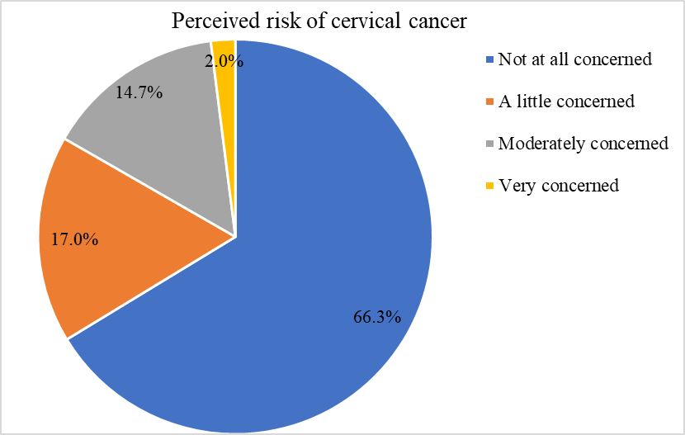
Results/Discussion ...
Perceived Risk of Cervical Cancer among OOSAGs
66.3% not at all concerned
14.7% moderately concerned & only 2.0% very concerned
Vaccine Confidence (OOSAGs)
31.6% rated HPV vaccine very important & moderately important
27.7% considered it very safe, 32.5% moderately safe
84.7% had not heard negative information in past 12 months
Main concerns: fertility (20.8%), pain (8.2%), side effects (5.2%)
Notes:
Emphasize that risk perception is very low. This undermines motivation to vaccinate, since many girls and caregivers don’t feel cervical cancer is a threat.
Confidence is mixed: importance is recognized, but safety perceptions are more cautious. Fertility concerns stand out as a barrier. Positive: most girls haven’t been exposed to misinformation.

Slide 19
Results/Discussion ...
Information Access and Trusted Sources (OOSAGs)
54.1% did not know where to find reliable information
Health facilities (44.4%) and parents (17.3%) were main sources
25.3% reported no source at all
Trusted advisors: health workers (59.5%), family (30.2%)
Trust in health workers: 71.4% moderate to very high
Notes:
Stress the central role of health workers as trusted advisors. Limited access to reliable information is a major barrier. Parents also play a strong role, reinforcing the importance of caregiver engagement.
Confidence is mixed: importance is recognized, but safety perceptions are more cautious. Fertility concerns stand out as a barrier. Positive: most girls haven’t been exposed to misinformation.

Slide 20
Results/Discussion ...
Motivation/Intention to Receive the HPV Vaccine
Among unvaccinated girls (n=482):
80.1% intend to be vaccinated
7.9% do not want the vaccine
12.0% undecided
This shows potential for improvement through targeted communication & trust-building interventions
Communication Barriers (Health Workers & Family)
40.1%: “Not at all” easy to discuss SRH with health workers
Only 6.1%: “Very easy”
With family: 23% “Not at all” comfortable, 31.2% “A little,” 36.4% “Moderately,” 9.1% “Very comfortable”
The difficulty girls face in discussing SRH with health workers and family limits opportunities for vaccine counseling
Provider communication not only conveys information but functions as a cue to action, increasing parents’ perceived need for vaccination [Oh, N.L., et al., 2021].W
Notes:
Stress that motivation is moderate but promising — over half of unvaccinated girls want the vaccine. This shows potential for improvement if communication and trust-building are strengthened.
Highlight the difficulty girls face in discussing SRH with health workers and family. This limits opportunities for vaccine counseling.

Slide 21
Results/Discussion ...
Social Norms and Influences
36% believe peers will get vaccinated
37% know someone vaccinated
58% report family/friends encourage vaccination
Religious leaders (63%), teachers (67%), community leaders (69%) perceived as supportive
Only 35% received direct advice from a health worker
Notes:
Point out the gap: while community influencers are supportive, health worker recommendations remain limited. This is a missed opportunity for provider-driven reinforcement.

Slide 22
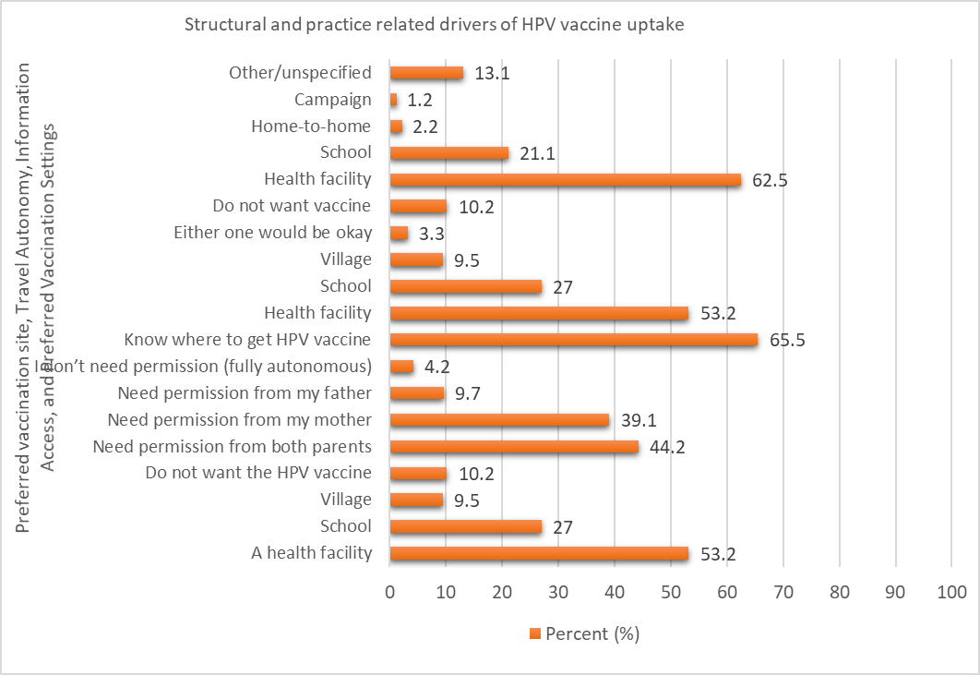
Results/Discussion ...
Decision-Making Autonomy as reported by OOSAGs)
46.6%: Mother is primary decision-maker
43.3%: adolescent girl herself
10.1%: Father
Preferred Vaccination Sites & Travel Autonomy
Preferred site: 53.2% health facility, 27% school, 9.5% village
Travel autonomy: 44.2% need permission from both parents, 39.1% from mother, 9.7% from father, only 4.2% fully autonomous
65.5% knew where to access vaccine; health facilities most cited (62.5%)
Notes:
Point out the gap: while community influencers are supportive, health worker recommendations remain limited. This is a missed opportunity for provider-driven reinforcement.
Stress that health facilities are preferred, but mobility restrictions and parental permission are major barriers.

Slide 23
Results/Discussion ...
Service Delivery Barriers
Access: Only 10.1% “very easy” & 37.1% rated “a little easy”
Consent: 42% “not at all easy” & 11% the process “very easy”.
Availability: 96.4% reported vaccine not available
Health worker recommendation: only 35.4% advised vaccination
Documentation: only 24.7% had vaccination card
Service Satisfaction & Quality
Satisfaction: 46.5% moderately satisfied, 46% very satisfied
Concerns: Vaccine unavailability (55% in facilities, 79% in schools), lack of privacy (5% in schools)
Notes:
Highlight systemic barriers: vaccine unavailability, difficult consent, weak documentation. These structural issues undermine uptake even when motivation exists.
Note that satisfaction is high among those who received services, but unavailability remains the dominant concern. This shows demand exists, but supply is failing.

Slide 24
Results/Discussion ...
Overall prevalence of parental confidence in vaccine safety: 72.6% (95% CI: 69.1–75.9)
Awareness and Confidence (Parents/Caregivers)
Only 21.6% correctly identified HPV as cause of cervical cancer
35.9% had heard of HPV vaccine
Among those aware, 81% recognized its preventive role
74.6% regarded vaccine as at least moderately important while 42.1% rated it very important
72.5% considered vaccine moderately safe or better; 35% very safe
Notes:
Parents show stronger confidence than girls, but awareness remains limited. Their role as primary decision-makers makes them critical targets for communication and health worker recommendations.

Slide 25
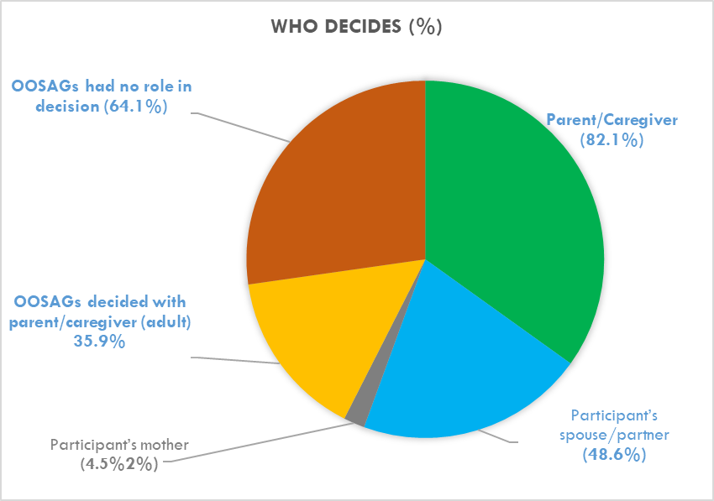
Results/Discussion ...
Decision-Making Autonomy (Parents/Caregivers)
82.1%: parent/caregiver is primary decision-maker
48.6%: spouse/partner also involved
64.1%: adolescent girl had no role in decision
35.9%: decision made jointly with child
Notes:
Emphasize that mothers are the dominant decision-makers, but joint decision-making with girls is not negligible. This highlights the need for caregiver-focused interventions while also empowering adolescents.

Slide 26
Results/Discussion ...
Key Predictors of HPV Vaccine Uptake in OOSAGs in underserved geographic area
Awareness of cervical cancer → 4.6× more likely to be vaccinated (AOR = 4.63, p < 0.001)
→ Awareness of disease severity and preventability strongly predicts vaccine acceptance (BeSD framework, Tiruye, Get al, 2025)
Awareness that a virus causes cervical cancer → 5.5× more likely (AOR = 5.55, p = 0.008)
Biological understanding of HPV as cause of cervical cancer (Enyew, E. B., et al, 2025)
Knowledge of where to access information → 2.2× more likely (AOR = 2.20, p = 0.008)
→ Trusted local information sources (messengers) like health workers, religious leaders) reduce fears and moral (WHO, 2022)
Inclusive communication and education strategies are urgently needed to increase HPV vaccine uptake among out-of-school adolescent girls in underserved LMIC regions
Notes:
Emphasize that awareness and information access are the strongest drivers of uptake. These findings highlight the importance of communication, education, and reliable information channels.
Stress that parental confidence is shaped by both awareness and trust in health workers. Health worker recommendations are particularly influential, underscoring the need to strengthen provider-driven communication.

Slide 27
Results/Discussion ...
Factors Associated with Parental Confidence in HPV Vaccine Safety in OOSAGs in underserved geographic area
Intention to vaccinate child → 5.1× more likely to be confident (AOR = 5.14, p < 0.001)
→ Parental intention is a robust predictor of vaccine acceptance (Mohammed, K.A., et al, 2017; Tiruye et al., 2025)
Awareness of cervical cancer → 3.0× more likely (AOR = 3.03, p = 0.039)
→ Low awareness is a known barrier; better knowledge increases confidence (Dereje, N., et al., 2021;Addisu, D., 2023; Herbie et al., 2023)
Confidence in health workers → 3.1× more likely (AOR = 3.08, p = 0.005)
→ Provider trust reduces parental safety concerns (Zepro et al., 2023)
Health worker recommendation → 2.7× more likely (AOR = 2.66, p = 0.005)
→ Provider cue to action increases parents' perceived need (Hailemariam et al., 2021)
Inclusive communication & targeted Health education strategies are urgently needed to increase confidence in HPV vaccination for similar populations (Jin, S.W., 2023)
Notes:
Emphasize that awareness and information access are the strongest drivers of uptake. These findings highlight the importance of communication, education, and reliable information channels.
Stress that parental confidence is shaped by both awareness and trust in health workers. Health worker recommendations are particularly influential, underscoring the need to strengthen provider-driven communication.

Slide 28
Strengths and Limitations of the Study
Strengths
Large sample size with high response rate
Use of WHO BeSD framework ensures global comparability
Focus on underserved, out-of-school adolescents fills a critical evidence gap
Multivariable regression identifies independent predictors of uptake and confidence
Limitations
Cross-sectional design limits causal inference
Recall & social desirability bias possible due to self-reported data
Study limited to selected regions & OOSAGs, findings may not generalize other areas
Some health system factors (e.g., vaccine supply chain) not fully captured
Parental perspectives critical but not explored in depth beyond confidence & decision-making
Notes:
Acknowledge strengths to show credibility, but transparently note limitations. Stress that despite these, the findings provide actionable insights for policy and program design.

Slide 29
Conclusions
Awareness & Education: Develop culturally appropriate, community-based programs using trusted leaders (health extension workers, religious leaders, women’s groups)
Outreach Services: Expand vaccination beyond schools, mobile clinics, door-to-door campaigns, village-based delivery
Provider Engagement: Train health workers to deliver clear, evidence-based counseling; integrate HPV counseling into maternal & child health services
Informmation Access: Establish reliable channels (community forums, youth services, local media) for HPV-related information
Policy Integration: Ensure HPV strategies address behavioral, social, and structural factors to promote equitable coverage
Notes:
Frame recommendations as actionable steps for policymakers, implementers, and community stakeholders.

Slide 30
Policy Implications/Recommendations
Awareness campaigns are critical: knowledge gaps directly reduce uptake.
Strengthening health worker recommendations builds parental confidence.
Reliable information access doubles the likelihood of vaccination.
Interventions must target both demand-side (awareness, motivation) and supply-side (provider communication, service delivery).
Notes:
Summarize the regression findings into actionable insights. Stress that both adolescent girls and parents need targeted awareness, while health workers must be empowered to recommend vaccination consistently.

Slide 31


Acknowledgements
We deeply grateful for:
Special thanks go to the field supervisors, language translators, and data collectors
Our heartfelt appreciation to the OOSAGs & their parents/caregivers who participated in this study
UNICEF Ethiopia: for funding and support
EPHA IRB: for their ethical review and approval
Immunization Service Desk at the MCAH Lead Executive Office @MOH

Slide 32
Thank you!

